Slide 1


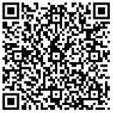

We are recruiting new student tutors for our Engineering Scholars programme.
Tutors will provide tutoring in maths and physics to S5/S6 school pupils from underrepresented groups, who aspire to a career in engineering.
If you would like to earn some extra money and enhance your CV, please apply using this link to the application form.
.
For more info email: eng-scholars@strath.ac.uk

