Slide 1


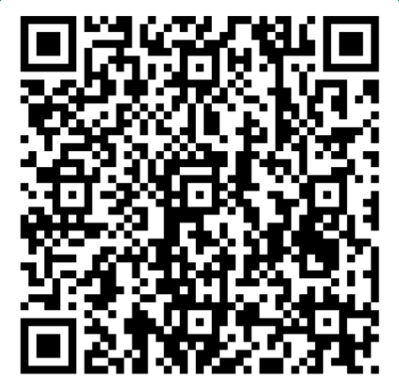
We are recruiting Scholars
What is Strathclyde Engineering Scholars?
Strathclyde Engineering Scholars is a program which aims to positively impact the diversity of people studying engineering at university. Ultimately, this will help ensure that the engineering profession is representative of the diversity that exists in society.
What are the Benefits?
Regular personal or small group academic tutoring and coaching
Mentoring from current students and professional engineers
Industry case studies, insights and events
Campus visits
Offered free to Scholars
Who can apply?
How can you apply?
Anyone residing in Scotland with a genuine interest
in studying engineering at university, and who meets the criteria below, can apply or be nominated to become a Strathclyde Scholar:
Complete the form by following the link at:
https://forms.office.com/e/K0QQBWufww
We welcome applications from:
· People applying for their own place
Nominations on behalf of the applicant by:
· Parents
· Carers
· Youth Leaders
· Teachers
· Extended family
· Friends
Before you nominate
someone please ask
their permission
· Senior school pupils due
to sit SQA Highers or
Advanced Highers in 2024
· College students studying
engineering and
considering applying to
university
· Should hold or be sitting
SQA Higher Maths and
Physics/Engineering
Science*
And meet at least one of
the following criteria
· reside in SIMD 0-40 or
rural area
· attend a school with low progression rates to
university
· be eligible for free school meals
· carer or care experienced
Deadline for applications 5pm Friday 29th September
More information available at:
https://www.strath.ac.uk/engineering/outreach/strathclydeengineeringscholars or email eng-scholars@strath.ac.uk
*or relevant combination of Maths/Physics/Engineering Science/Science subjects required for entry to course of interest as stated at www.strath.ac.uk

